Slide 1
Sales Management Project

Slide 2

Introduction
A fictitious global electronics retailer has a demand to have a clear understanding of key performance indicators and trends.
Project Objective
To analyze and present comprehensive insights into sales, profit, orders, profit margin, and various comparisons.
To provide stakeholders with the data they need to make informed decisions.
End result: An automated dashboard providing quick & latest sales insights in order to support data driven decision making.

Slide 3
Data Cleansing & Transformation
Data resource: link
In each data table, there are some columns that do not need to be used. So i only select certain columns that are useful for analysis.
To create the necessary data model for doing analysis and fulfilling the business needs defined in the user stories the following tables were extracted using SQL.
Below are the SQL statements for cleansing and transforming necessary data.

Slide 4
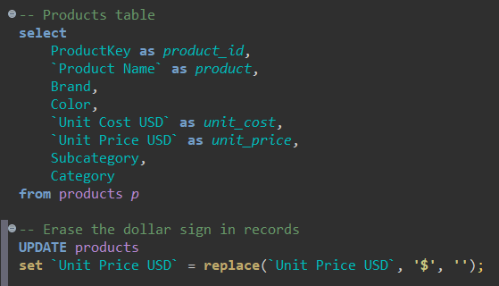
Data Cleansing & Transformation
Products table
For calculating purpose,I trimmed the dollar sign to change the data types of `Unit Cost USD` column and `Unit Price USD` column to decimal.

Slide 5
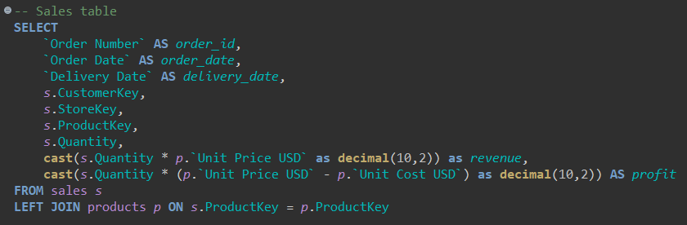
Data Cleansing & Transformation
Sales table
I join the Sales table into the Products table to calculate the field
Revenue and Profit

Slide 6
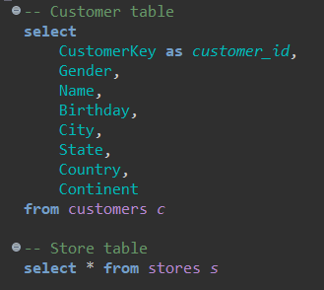
Data Cleansing & Transformation
Customer table and Store table

Slide 7
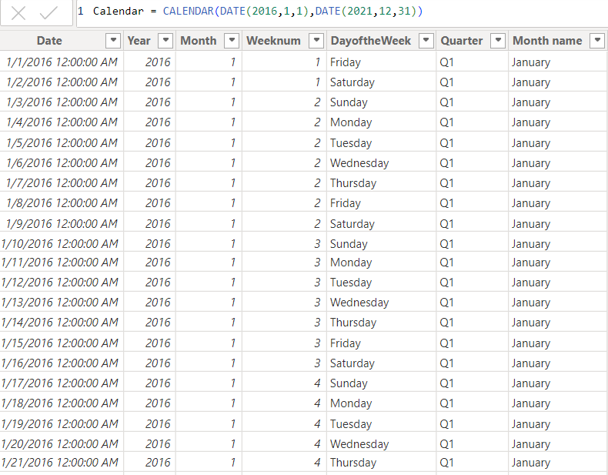
Data Cleansing & Transformation
Calendar table
To organize and manage time-related data, I created a calendar table using Power BI.

Slide 8
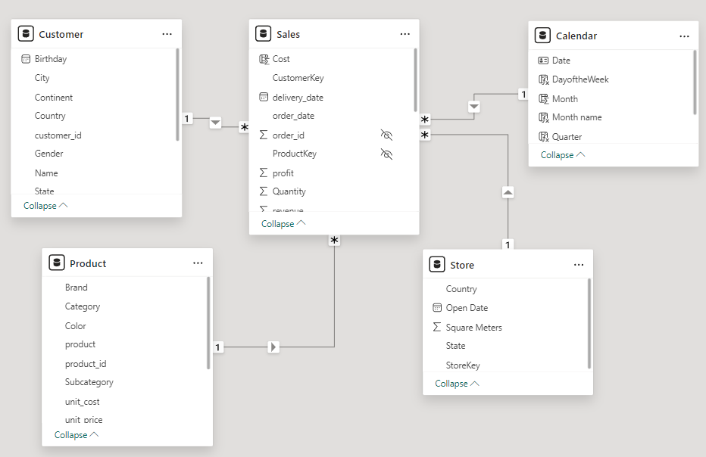
Data model
This is a screenshot of the data model after cleansed and prepared tables were read into Power BI.
This data model also shows how FACT_Sales has been connected to other necessary DIM tables.

Slide 9
DAX Calculations
To include additional dimensions, hierarchies and aggregations that are not part of the original dataset, i created some measures and columns using DAX.
Measures Total Sales: Sales = SUM(Sales [revenue])
Measures Previous Year Toal Sales: Sales PY = CALCULATE([Sales], SAMEPERIODLASTYEAR(Calendar[Date]))
Diffrence Between Current Year Sales & Previous Year Sales: Sales vs PY = [Sales] - [Sales PY]
Percentage Increase or Decrease in sales year on year (YOY%): Sales vs py % = DIVIDE([Sales vs PY],[Sales],0)
Products Sold = SUM(Sales[Quantity])
Profit = SUM(Sales[Profit])
Profit LY = CALCULATE([Profit], SAMEPERIODLASTYEAR(Calendar[Date]))
Profit Vs LY = [Profit]- [Profit LY]
Profit vs LY % = [Profit Vs LY]/[Profit]
Profit Margin = DIVIDE([Profit],[Sales],0)
Total Cost = SUM(Product[unit_cost])

Slide 10
Dashboard
Press CTRL and click the image to open the dashboard and try it out!

Slide 11
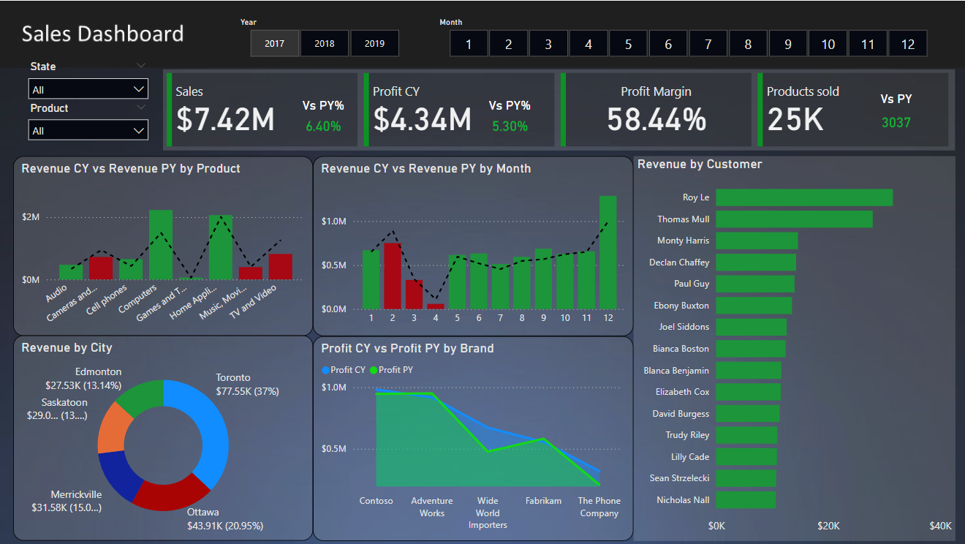

Slide 12
Thanks
Name: Minh Quan
Email: quan09102002@gmail.com

